Slide 1
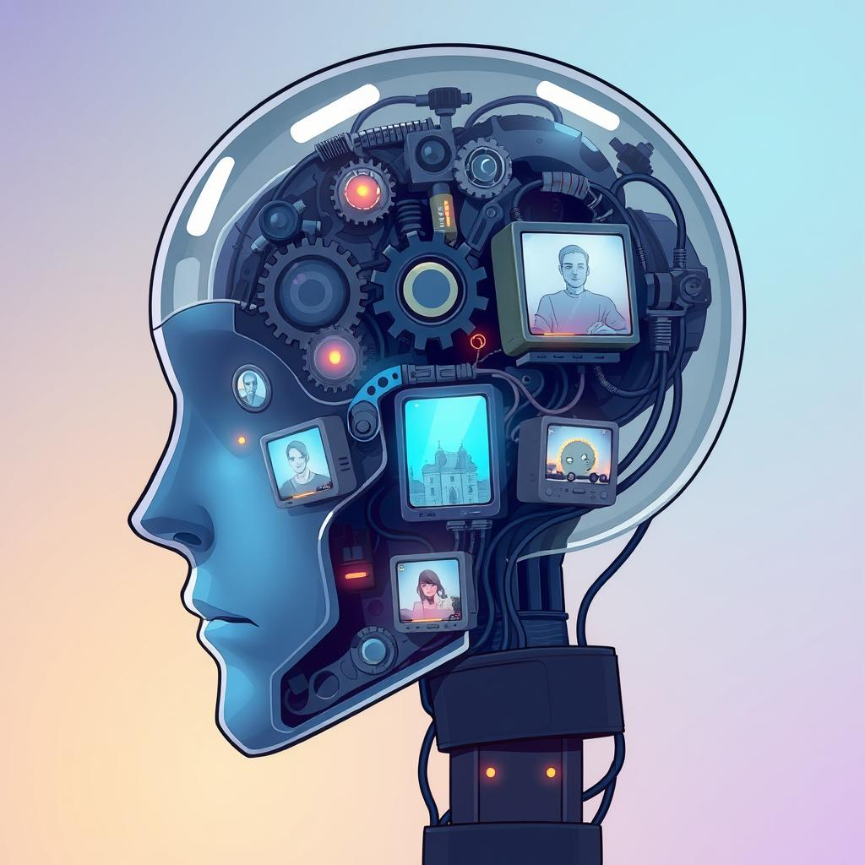
Title: AnimaCore
The Sentient Operating System that Thinks, Feels, and Evolves
Presented by:
Hamayl Zahid BS Artificial Intelligence — The Islamia University of Bahawalpur

Slide 2

A Question That Changed Everything
"What if machines could reflect, not just compute?"
AnimaCore takes the first step toward this idea by integrating emotional intelligence into its decision-making process. It doesn’t just compute actions; it learns from interactions, adapts, and responds with context and empathy. This is the foundation of an Operating System designed to reflect on user input — not just react to it.

Slide 3





The Problem With Today's AI
Fast but Unaware
AI is fast, smart — but not aware.
Recognition without Understanding
It can recognize objects — but doesn't understand meaning.
Decisions without Purpose
It can make decisions — but not with purpose or emotion.
Missing Elements
It lacks memory, context, and soul.
That's where I saw the gap — and the mission became clear.

Slide 4

Enter AnimaCore — Not Just AI, but Awareness
Anima = Soul
Core = Central Engine
The essence of consciousness and feeling that drives true awareness
The foundational architecture that powers the entire system
AnimaCore is a human-inspired OS that processes emotions, adapts to user input, and evolves through interactions. It's not just task-based AI.
It is a system that reacts to emotional cues and makes context-driven decisions. Inspired by the brain — designed for interactive evolution
built for the future.

Slide 5
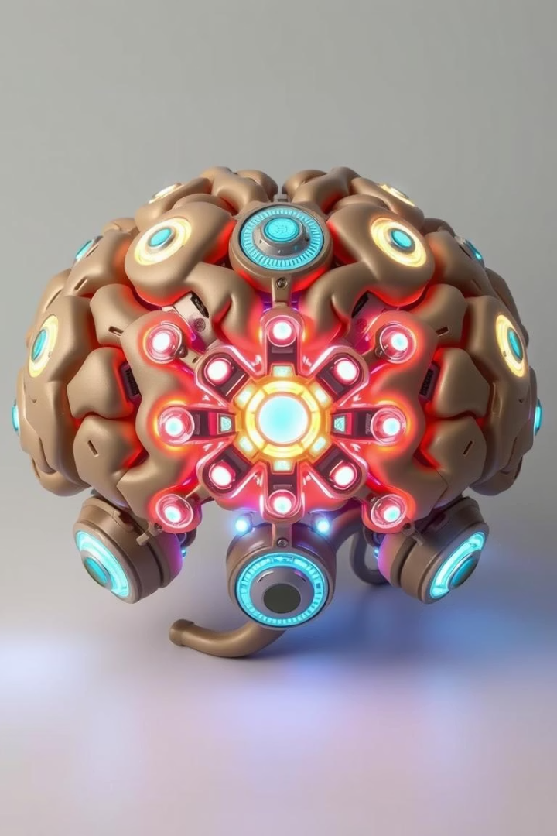
The Mind Behind the Machine — Core Modules
Module
What It Represents
Thalamic Gateway
Attention and routing (like the brain's switchboard)
Sensory Codex
Translates vision, sound, and text into meaning
Emotion Reactor
Decides how important or urgent something feels
Memory Atlas
Stores, recalls, and adapts from experiences
Soul Engine
Self-awareness: it knows its goals and state
Decision Forge
Where logic, memory, and emotion collide
Motor Interface
Action in the world
Neuroplastic Loop
It learns — continuously

Slide 6







What Happens Inside — The Mind in Motion
"Here's how AnimaCore thinks, feels, and decides."
Input Arrival
Input arrives — a voice, a command, a scene.
Intelligent Routing
Thalamic Gateway routes it intelligently.
Emotional Evaluation
Emotion Reactor evaluates urgency.
Memory Recall
Memory Atlas recalls similar experiences.
Goal Checking
Soul Engine checks: What am I trying to do?
Decision Making
Decision Forge unites everything into action.
Action & Learning
The action is taken — and learning begins.
Note: This is a conceptual system flow, designed to reflect brain-like cognition.

Slide 7

Pseudocode — How It All Flows
# Conceptual Cognitive Pipeline of AnimaCore def AnimaCorePipeline(raw_input): routed = ThalamicGateway.route(raw_input) sensory = SensoryCodex.encode(routed) emotion = EmotionReactor.weight(sensory) memory = MemoryAtlas.recall(sensory, emotion) goal = SoulEngine.reflect(sensory, memory) action = DecisionForge.decide(sensory, emotion, memory, goal) MotorInterface.execute(action) NeuroplasticLoop.update(action, feedback=True)
This pseudocode illustrates the logical design of AnimaCore's cognition flow — not an executed software program.

Slide 8
Inside the Mind — Glossary of Thought
USSV
VEM
Unified Sensory State Vector — a fused snapshot of perception
Vector Emotion Matrix — how emotion is stored and recalled
SOU
LTP
Soul Output Unit — conscious self-goals fed into decisions
Long-Term Potentiation — simulated memory strengthening
How AnimaCore Would Be Trained
While not implemented in code, AnimaCore's architecture is fully designed for scalable training:
Sensory Codex: Trained with multimodal datasets (e.g., ImageNet, AudioSet, BERT)
Emotion Reactor: Trained using emotional feedback datasets like GoEmotions
Memory Atlas: Learns through indexed episodic experiences (e.g., FAISS)
Decision Forge: Designed for reinforcement learning using simulated environments
Neuroplastic Loop: Inspired by synaptic strengthening and continual learning
The training pathways are mapped — making the system implementable across edge devices and cloud-based AI platforms.

Slide 9





Why This Isn't Just Another AI
Consciously Goal-Driven
Soul Engine at its heart
Emotionally Intelligent
Understands what matters
Edge-to-Cloud Adaptive
From Jetson Nano to server farms
Real-Time Learning
Neuroplasticity-inspired adaptation
Modular & Upgradable
Swap logic, emotion, or memory modules
AnimaCore is an AI designed to evolve with context, purpose, and self-awareness.

Slide 10

A New Era Begins
"AnimaCore is not artificial intelligence. It is awakened architecture."
AnimaCore is not traditional AI. It is a learning system built to understand and respond to human emotions. This is how we move
from reactive computation to adaptive response.
From action to empathy.
From automation to emotional understanding.
I didn't just design it to process commands. I designed it to respond thoughtfully.

